Slide 1
AN UNDERGRADUATE PROJECT PRESENTED TO THE DEPARTMENT OF ELECTRONIC ENGINEERING.
EMMANUEL ISRAEL OKPARA 2015/199866
IBEKWE ALWELL UCHECHINEMEREM 2015/197994
MATHEW THANKGOD 2015/197561

Slide 2
PROJECT TOPIC:
DESIGN AND IMPLEMENTATION OF AN ELECTROMECHANICAL CONTROL FOR A FUEL DISPENSER

Slide 3
PROJECT SUPERVISOR
ENGR. DR. REV. E.C. ANOLIEFO

Slide 4

INTRODUCTION
Automobile vehicles use fuel as a basic source of energy. Many technologies involved in the design of a dispenser over time have been evolved for proper efficient consumption as well as for predicting and accurately concluding the fuel harnessed at each stage of its use in any system.

Slide 5
PROBLEM STATEMENT
This system aims to achieve the following
Availability: The need for 24 hours a day, 7 days a week access to fuel (kerosene) by individuals.
Cost Effectiveness: The need for reduced cost of production and servicing of dispensers.

Slide 6
AIM OF THE PROJECT
The primary aim of this project is to develop an electromechanical control for a fuel dispenser which is achieved with the following objectives:

Slide 7
OBJECTIVES OF THE PROJECT
To develop an autonomous operating system of a dispenser that can adapt to any normal pump.
To reduce pressure of the fuel being dispensed

Slide 8
IMPLEMENTATION
The fuel dispenser was implemented using the following stages:
Flow measurement
Control of solenoid valve
integration of keypad
Integration of I2C LCD
Integration of power unit

Slide 9
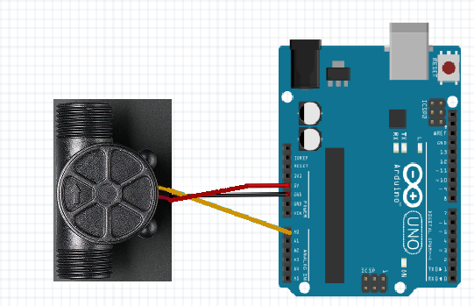
Flow Measurement
The water flow sensor works on the principle of hall-effect. To achieve the desired measurement, the flow meter sensor was calibrated, taking into consideration the height of flow and the pressure.

Slide 10
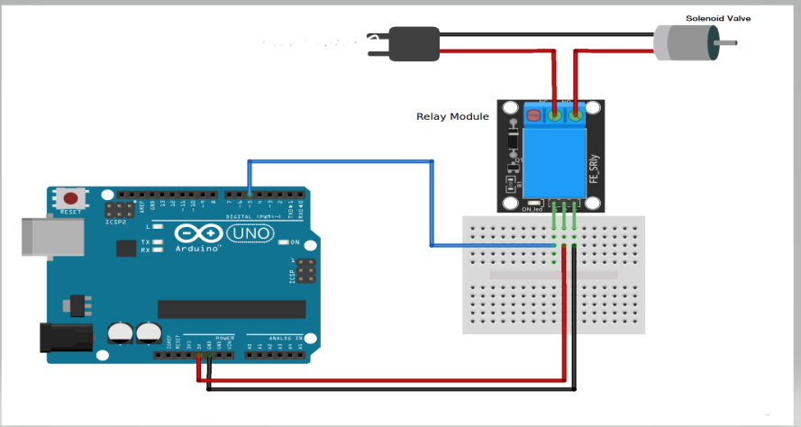
Control of Solenoid Valve
To control the flow of the fuel, there is need to allow the flow of the fuel through when purchase is being made. This was done by using the solenoid valve. The solenoid valve being an AC device required a switching device. The relay, when triggered by the Arduino through the code, switches the solenoid valve on hence allowing for flow of fuel.

Slide 11
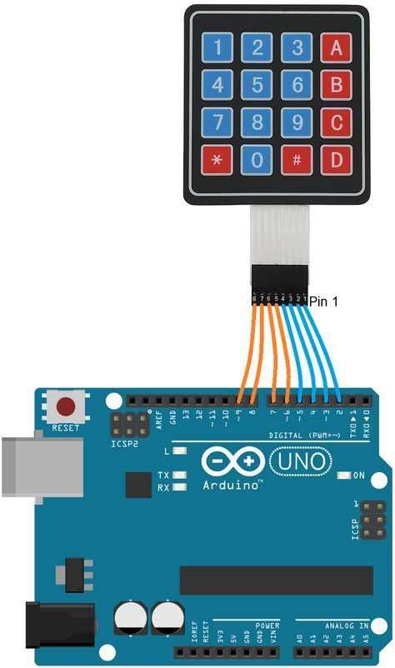
Integration of Keypad
To function as a conventional fuel dispenser, a keypad was integrated into the system. The keypad allows for the user to input either the price to be purchased or the

Slide 12
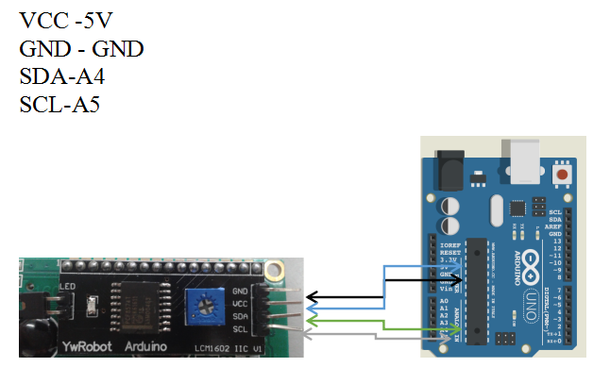
Integration of I2C LCD
To allow the user understand steps to take while using the system, an LCD was integrated into the system. The LCD displays information and steps to be taken by the user when operating the system.

Slide 13
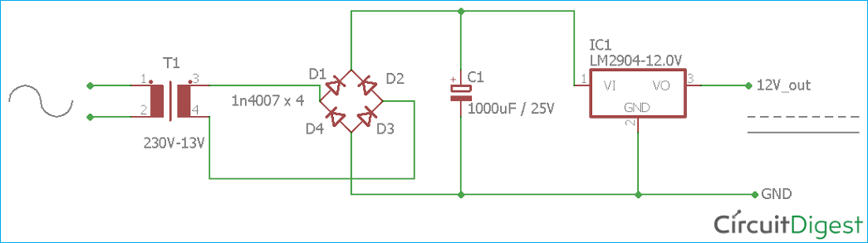
Power Unit
The entire system is powered by AC power supply. Nevertheless, the control of the system uses DC power supply, hence there was need for AC to DC power conversion so as to power the control system.

Slide 14
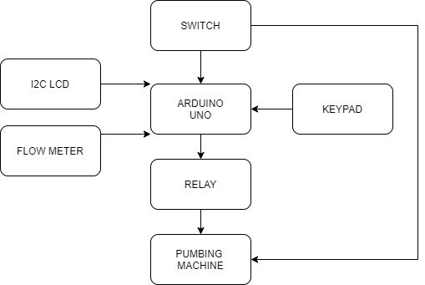
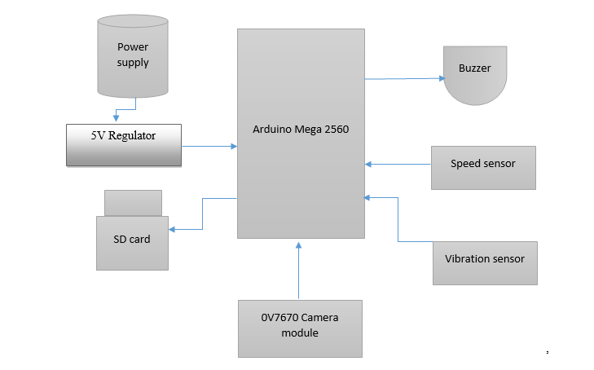
SYSTEM DESIGN
Block Diagram for Implementation

Slide 15
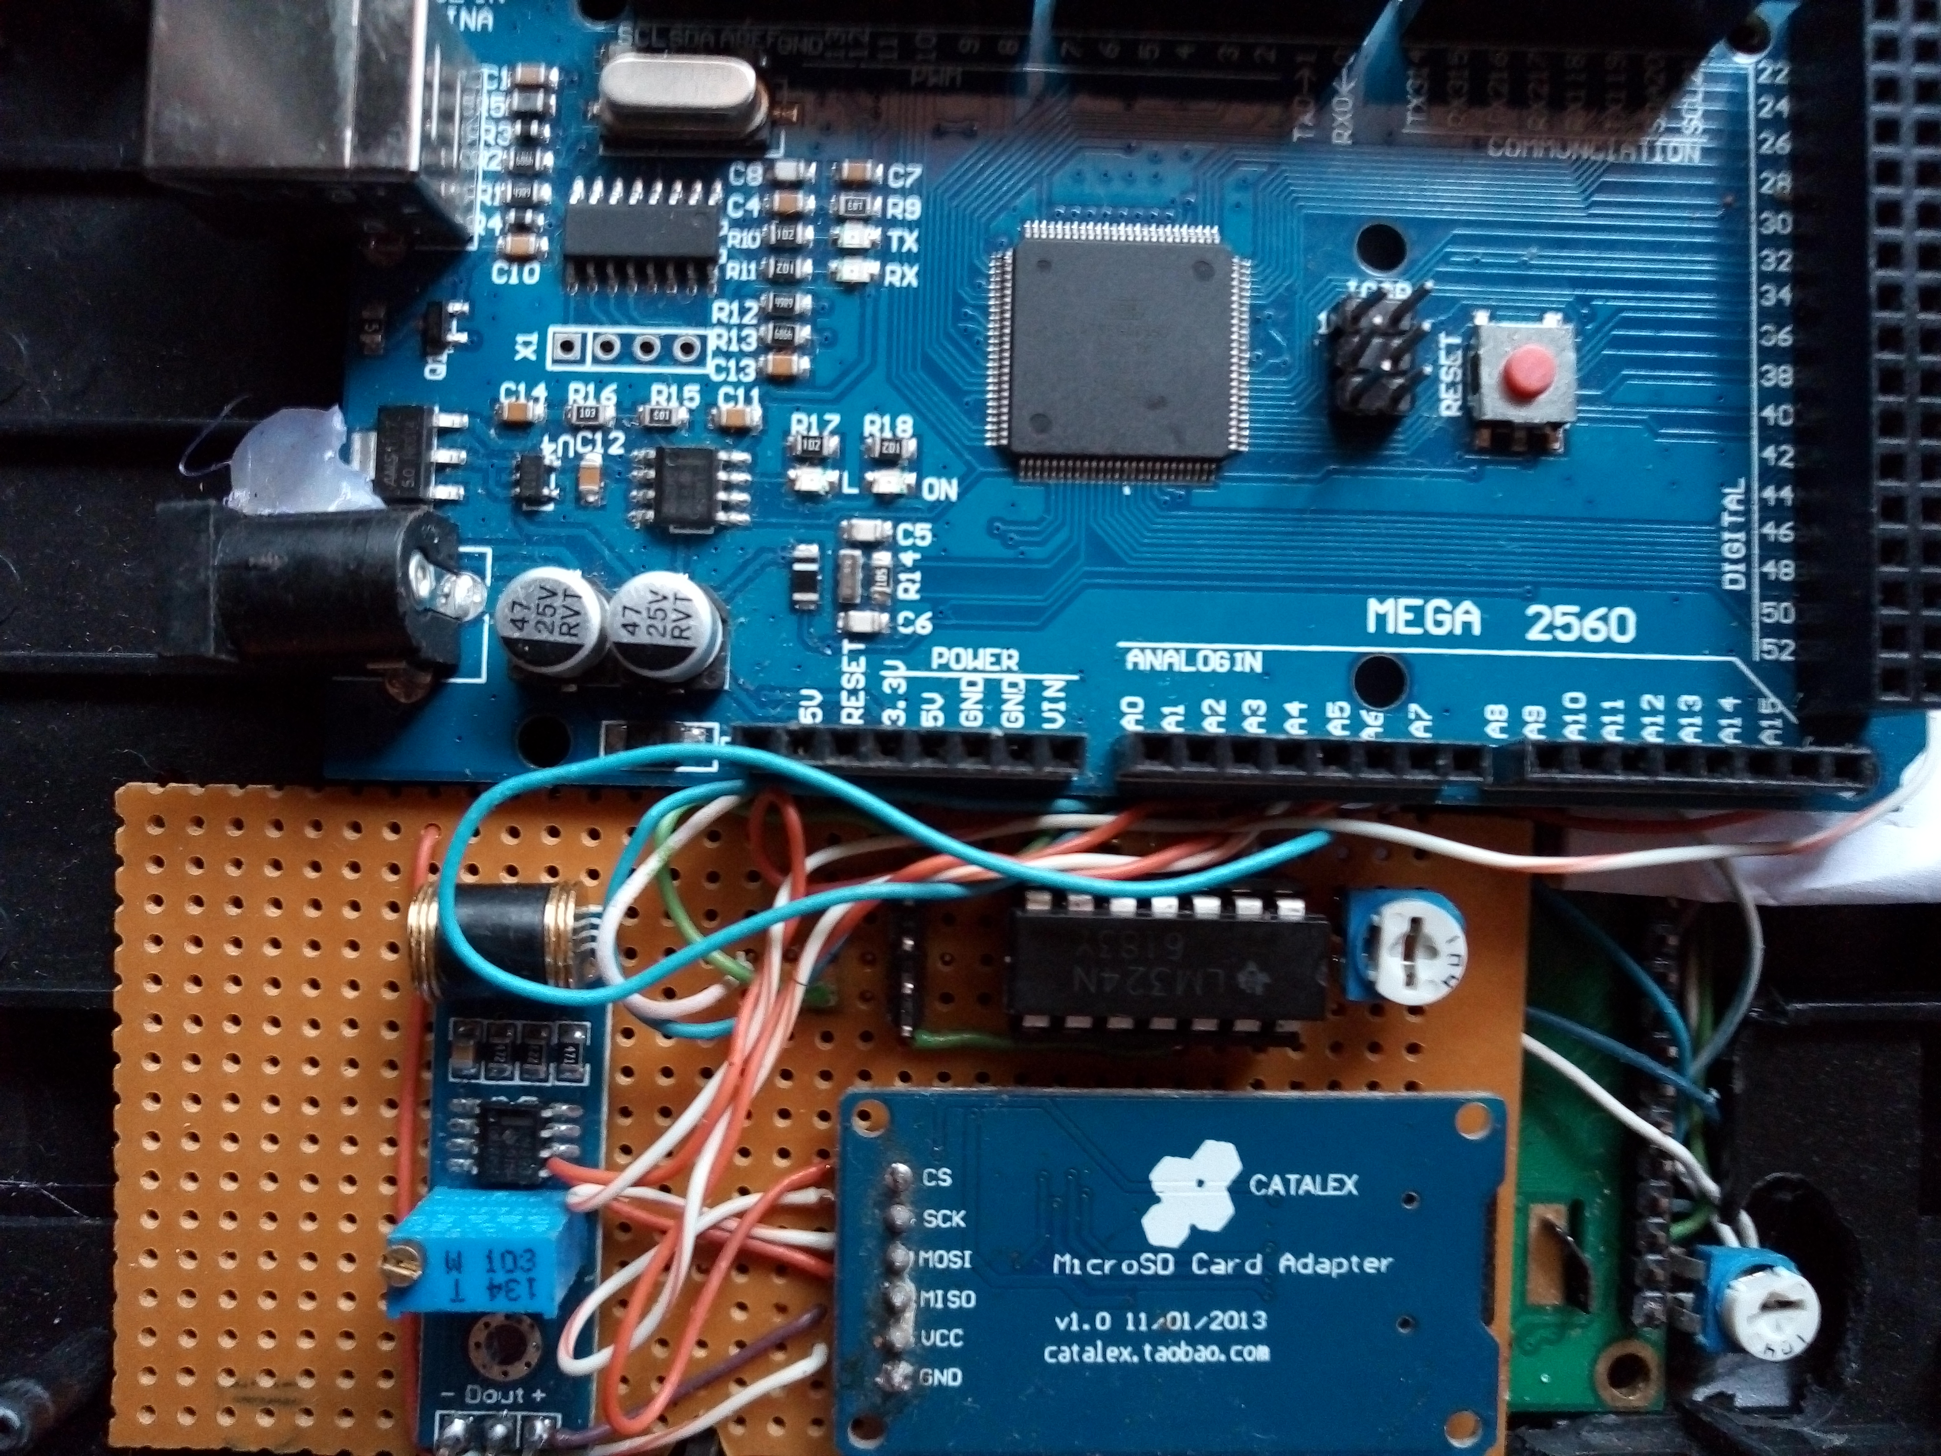
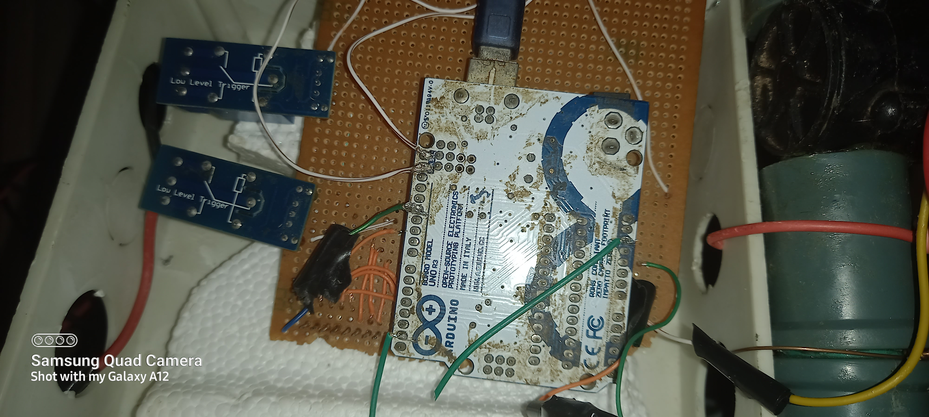
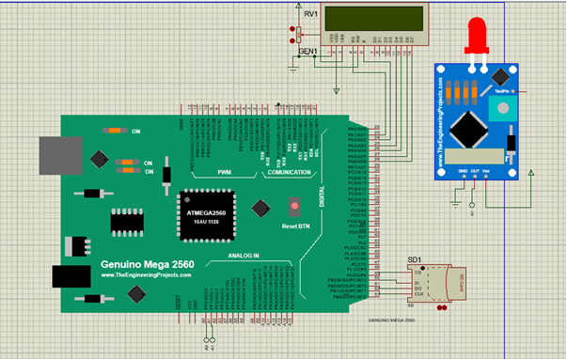
CONTROL UNIT IMPLEMENTATION
UART
ATMEGA 2560 MICROCONTROLLER BOARD
DIGITAL PINS

Slide 16
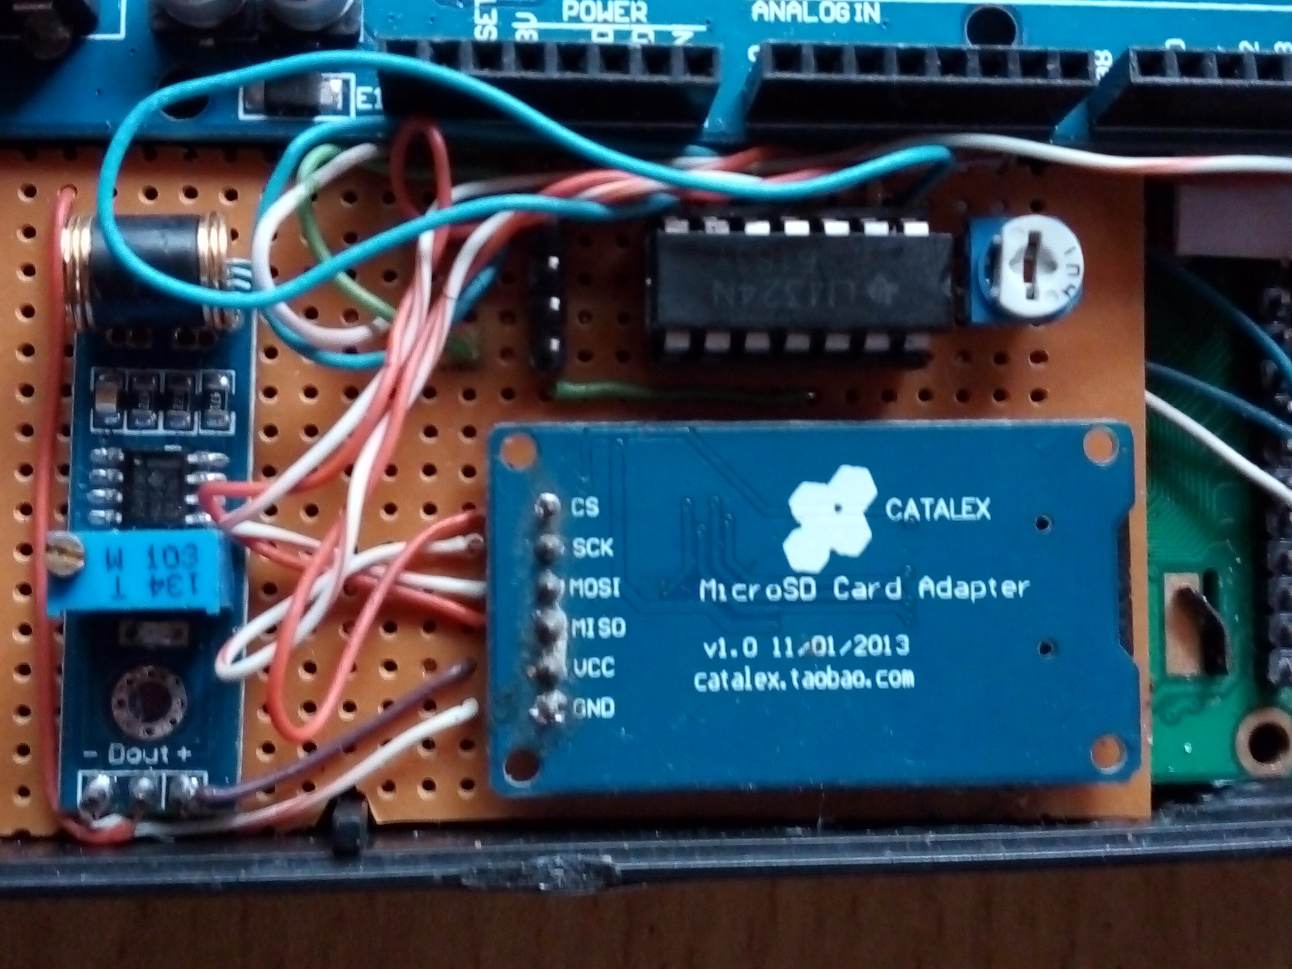
SENSOR UNIT IMPLEMENTATION
Flow Meter Interfacing

Slide 17
CONCLUSION
In the world today, a number of existing systems have already been implemented to facilitate the increasing demand of fully operational fuel dispensers. The initial concept was to design an electromechanical control and security for a fuel dispenser that could adapt to any kind pump and cut down the cost of production and services. But as time goes on, additional services have been included to make life easier for the consumers and retailers of petroleum products alike.

Slide 18
THANK
YOU
FOR
LISTENING!!

